Slide 1
COMPANY BANKRUpTCY PrEDICTION.
By – Abdul Rauf Khan.

Slide 2
Introduction –
Company bankruptcy prediction is a critical financial analysis process that involves assessing the likelihood of a business experiencing financial distress or insolvency in the future. This predictive analysis utilizes various financial, operational, and economic indicators to evaluate a company's overall financial health and stability. By employing statistical models, machine learning algorithms, and historical data, analysts and financial experts can identify early warning signs of potential bankruptcy, enabling stakeholders, such as investors, creditors, and management, to make informed decisions and take necessary actions to mitigate risks or address financial challenges. The accurate prediction of company bankruptcy is crucial for maintaining the stability of financial markets, protecting investors, and ensuring the sustainability of businesses in today's dynamic and competitive economic landscape.

Slide 3
Objective
Risk Mitigation:
Investor Protection:
Creditor Protection:
Operational Continuity:
Market Stability:
Efficient Resource Allocation:
Policy Development:
Credit Risk Management:
Strategic Decision-Making:
Data-Driven Insights:

Slide 4
Understanding our Variables Financial Ratios: Debt-to-Equity Ratio Current Ratio Quick Ratio Debt Ratio Earnings Before Interest and Taxes (EBIT) Margin Return on Assets (ROA) Return on Equity (ROE) Gross Profit Margin Liquidity Measures: Working Capital Cash Flow from Operations Cash Conversion Cycle Operating Cash Flow to Total Liabilities Solvency Ratios: Interest Coverage Ratio Debt Service Coverage Ratio Long-Term Debt to Capitalization Ratio Profitability Indicators: Net Profit Margin Earnings Before Interest, Taxes, Depreciation, and Amortization (EBITDA) Margin Operating Profit Margin Asset Quality and Efficiency: Inventory Turnover Accounts Receivable Turnover Asset Turnover Fixed Asset Turnover Market-Based Metrics: Market Capitalization Stock Price Volatility Price-to-Earnings (P/E) Ratio Price-to-Book (P/B) Ratio Credit Rating Changes: Changes in the company's credit ratings and creditworthiness assessments by rating agencies. Operational Metrics: Revenue Growth Rate Earnings Growth Rate Research and Development (R&D) Expenses Sales Growth Industry-Specific Factors: Variables specific to the company's industry, such as same-store sales growth for retail businesses or rig utilization rates for oil and gas companies. Macroeconomic Indicators: Factors like interest rates, inflation rates, and GDP growth that can impact a company's financial stability. Legal and Regulatory Variables: Pending legal actions, regulatory compliance issues, or any pending litigation. Ownership Structure: Changes in ownership, mergers, acquisitions, or significant divestitures. Management Quality: Changes in top management, their experience, and track record. Market Sentiment and News: Sentiment analysis of news articles and social media related to the company. Market Capitalization Trends: Changes in the company's market value over time. Historical Financial Performance: Trends and patterns in the company's financial statements, such as income statements, balance sheets, and cash flow statements. Bank Loan Covenants: Violation or adherence to loan covenants set by lenders. Macro-Economic Shocks: Events like economic recessions, currency fluctuations, or geopolitical crises that can affect a company's financial stability.

Slide 5
Steps to Build a Machine Learning Model
-Understand the problem.
-Data Collection, Data Preprocessing & Exploratory Data Analysis.
-Split the data.
-Choose an appropriate model.
-Train the model.
-Prediction.
- Accuracy Check

Slide 6
Exploratory Data Analysis Exploratory Data Analysis (EDA), also known as Data Exploration, is a step in the Data Analysis Process, where a number of techniques are used to better understand the dataset being used.
The main purpose of EDA is to help look at data before making any assumptions. It can help identify obvious errors, as well as better understand patterns within the data, detect outliers or anomalous events, find interesting relations among the variables.
Exploratory Data Analysis (EDA) can be used to answer questions about standard deviations, categorical variables, and confidence intervals. After completing EDA and drawing insights, its features can then be used for more sophisticated data analysis or modeling, including machine learning.

Slide 7
Feature Engineering
Feature Creation
Transformations
Feature Extraction
Feature Selection

Slide 8
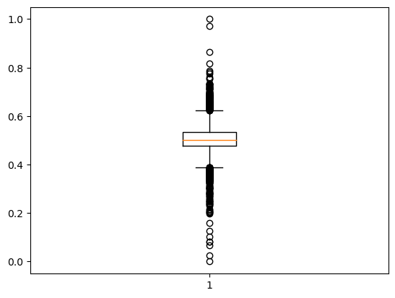
Some Insights of Data Chances of Bankruptcy in the provided Dataset ?
There are the Outliers present in the dataset

Slide 9
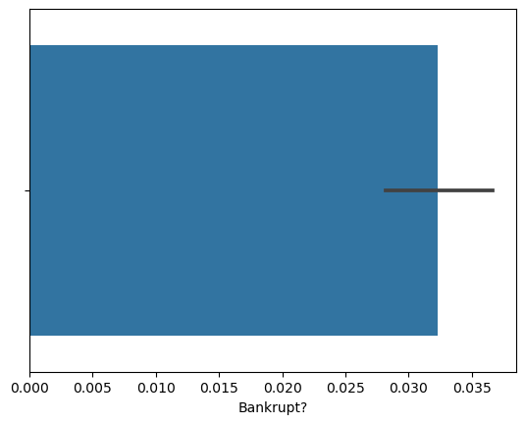
Some Insights of Data DATA of BANKruptcy in the companies.
These graph is based on Company Bankruptcy.

Slide 10
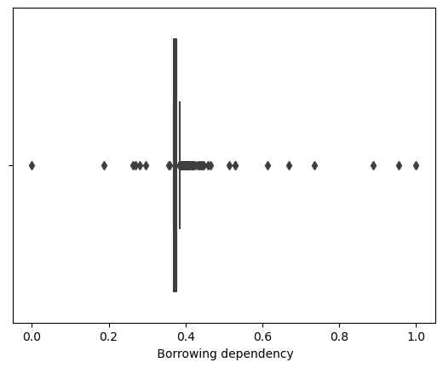
BOX plot of dataset
This is the actual borrowing data of the company.

Slide 11
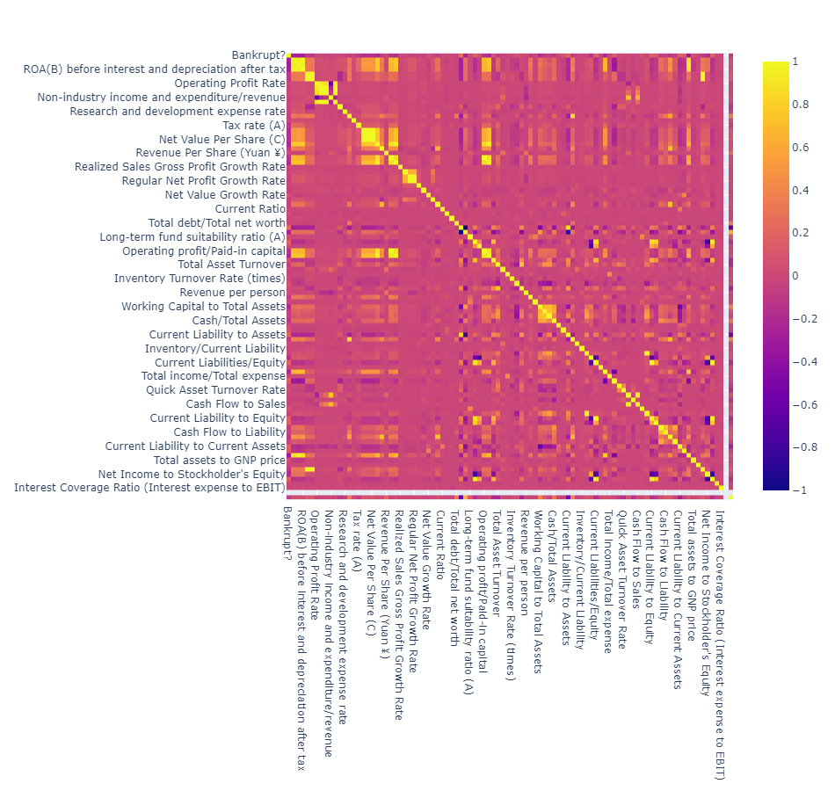
Pair plot for Dataset

Slide 12
Model Building
- Collecting Data
- Preparing the Data : Defining the Independent(X) and Dependent(Y) Variables
- After Defining , Splitting the data
- Choosing a Model
- Training the Model
- Evaluating the Model
- Making Predictions on the Test Data
- Check The Accuracy

Slide 13
Input Columns and Target Column
X = data[[' ROA(C) before interest and depreciation before interest', ' ROA(A) before interest and % after tax', ' ROA(B) before interest and depreciation after tax',
' Operating Gross Margin', ' Realized Sales Gross Margin', ' Operating Profit Rate', ' Pre-tax net Interest Rate', ' After-tax net Interest Rate',
' Non-industry income and expenditure/revenue', ' Continuous interest rate (after tax)', ' Operating Expense Rate', ' Research and development expense rate',
' Cash flow rate', ' Interest-bearing debt interest rate', ' Tax rate (A)', ' Net Value Per Share (B)', ' Net Value Per Share (A)', ' Net Value Per Share (C)',
' Persistent EPS in the Last Four Seasons', ' Cash Flow Per Share', ' Revenue Per Share (Yuan ¥)', ' Operating Profit Per Share (Yuan ¥)',
' Per Share Net profit before tax (Yuan ¥)', ' Realized Sales Gross Profit Growth Rate', ' Operating Profit Growth Rate', ' After-tax Net Profit Growth Rate',
' Regular Net Profit Growth Rate', ' Continuous Net Profit Growth Rate', ' Total Asset Growth Rate', ' Net Value Growth Rate', ' Total Asset Return Growth Rate Ratio',
' Cash Reinvestment %', ' Current Ratio', ' Quick Ratio', ' Interest Expense Ratio', ' Total debt/Total net worth', ' Debt ratio %', ' Net worth/Assets',
' Long-term fund suitability ratio (A)', ' Borrowing dependency', ' Contingent liabilities/Net worth', ' Operating profit/Paid-in capital', ' Net profit before tax/Paid-in capital',
' Inventory and accounts receivable/Net value', ' Total Asset Turnover', ' Accounts Receivable Turnover', ' Average Collection Days', ' Inventory Turnover Rate (times)',
' Fixed Assets Turnover Frequency', ' Net Worth Turnover Rate (times)', ' Revenue per person', ' Operating profit per person', ' Allocation rate per person',
' Working Capital to Total Assets', ' Quick Assets/Total Assets', ' Current Assets/Total Assets', ' Cash/Total Assets', ' Quick Assets/Current Liability',
' Cash/Current Liability', ' Current Liability to Assets', ' Operating Funds to Liability', ' Inventory/Working Capital', ' Inventory/Current Liability',
' Current Liabilities/Liability', ' Working Capital/Equity', ' Current Liabilities/Equity', ' Long-term Liability to Current Assets',
' Retained Earnings to Total Assets', ' Total income/Total expense', ' Total expense/Assets', ' Current Asset Turnover Rate', ' Quick Asset Turnover Rate',
' Working capitcal Turnover Rate', ' Cash Turnover Rate', ' Cash Flow to Sales', ' Fixed Assets to Assets', ' Current Liability to Liability',
' Current Liability to Equity', ' Equity to Long-term Liability', ' Cash Flow to Total Assets', ' Cash Flow to Liability', ' CFO to Assets',
' Cash Flow to Equity', ' Current Liability to Current Assets', ' Liability-Assets Flag', ' Net Income to Total Assets', ' Total assets to GNP price',
' No-credit Interval', ' Gross Profit to Sales', ' Net Income to Stockholder's Equity', ' Liability to Equity', ' Degree of Financial Leverage (DFL)',
' Interest Coverage Ratio (Interest expense to EBIT)', ' Net Income Flag', ' Equity to Liability' ]]
]]
Y = data[‘Bankrupt?']

Slide 14
Implementing Models Here are a few ALGORITHMS which are applied to this Dataset
Models: Accuracy:
Logistics Regression 96.66%
Decision Tree 97.00%
Random Forest `96.70%

Slide 15
Conclusion -Logistics Regression was Performed with an Accuracy of 96.66% on Testing Data. -By Predicting these values we can get an understanding due to which factors any person gets heart related disease.

Slide 16
-Decision Tree was Performed with an Accuracy of 97.00% on Testing Data. -By Predicting these values we can get an understanding due to which factors any person gets heart related disease.

